Slide 1



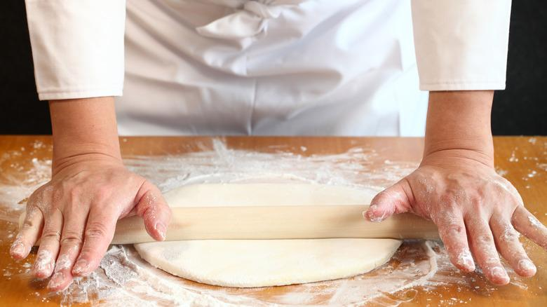
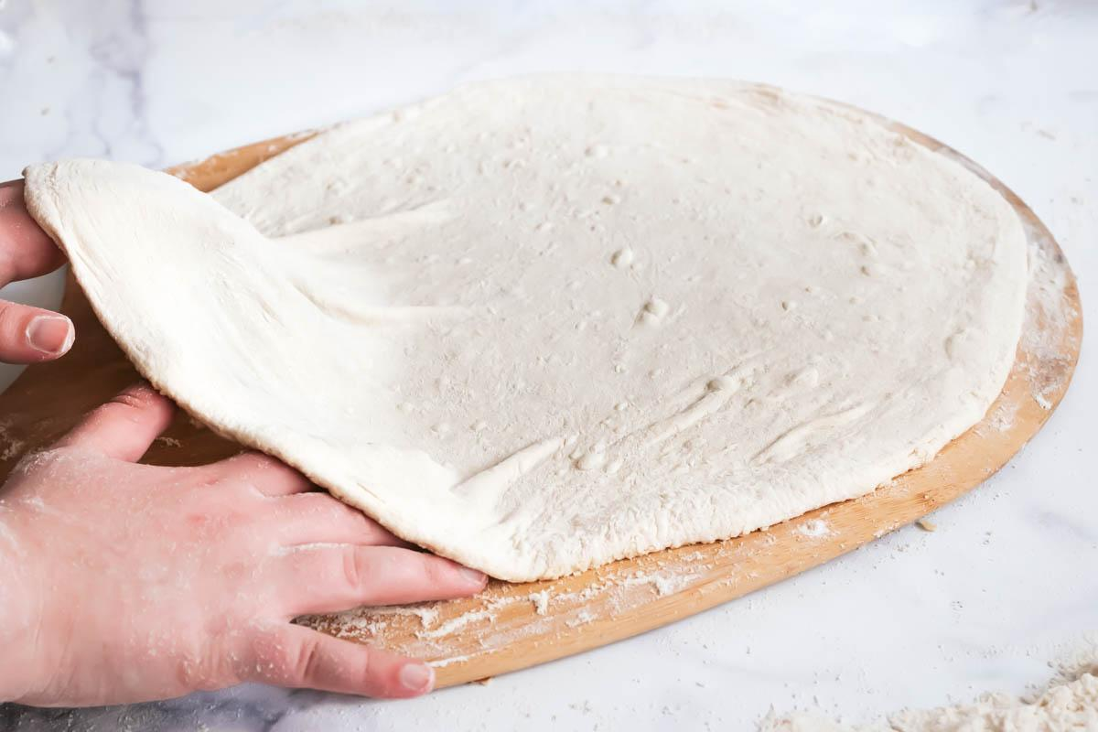
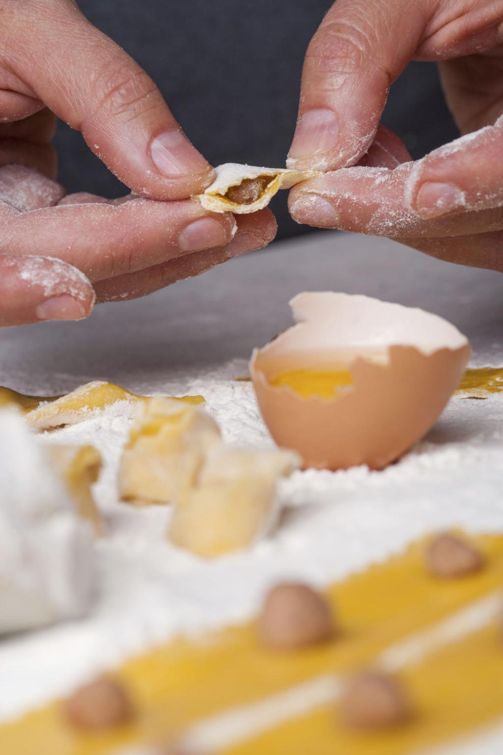
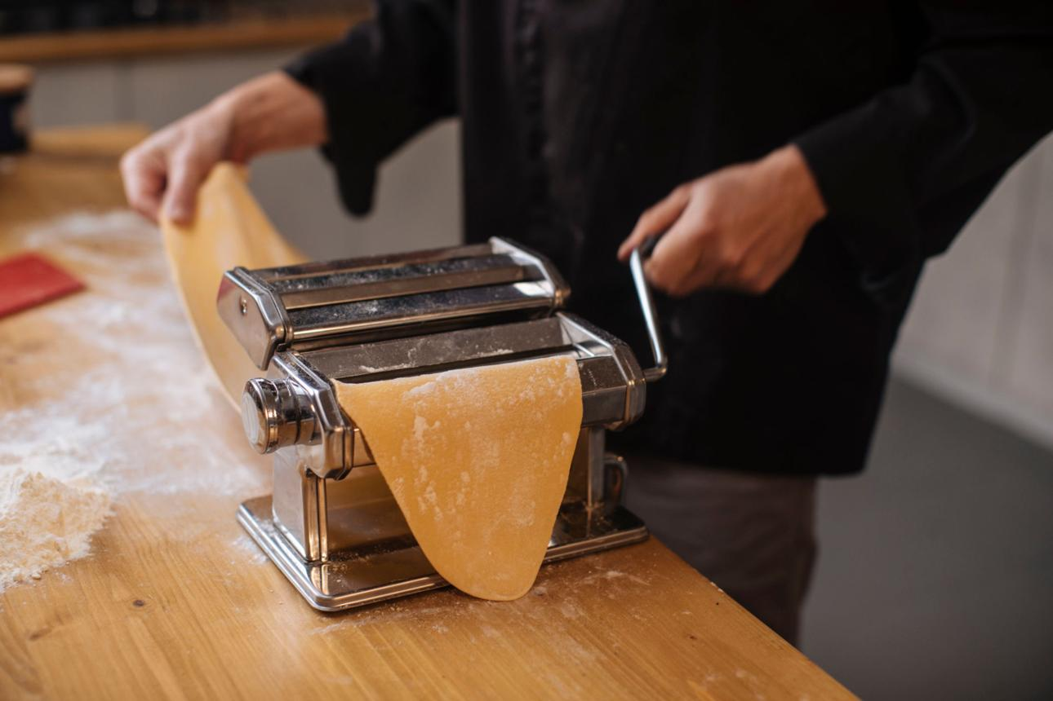
gluten

Slide 2









AIM
To study the formation of gluten in wheat flour.
To understand the role of water and mechanical action in gluten development.
To analyze how gluten contributes to dough structure and elasticity.

Slide 3



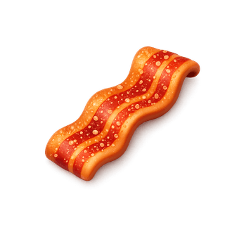


Principle
Gluten is formed when wheat flour proteins (gliadin and glutenin) interact with water.
Hydration allows these proteins to unfold and form intermolecular bonds.
Mechanical action (kneading) promotes cross-linking, forming a viscoelastic network.
This network traps gases and gives elasticity and extensibility to dough.

Slide 4





Basic Concept
Gluten consists of two main proteins:
Gliadin → provides viscosity and extensibility
Glutenin → provides elasticity and strength
On addition of water:
Proteins hydrate
Form hydrogen bonds and disulfide bonds
Result:
A three-dimensional protein network
This network is responsible for:
Dough structure
Gas retention
Final product texture

Slide 5

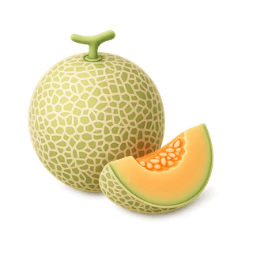



Major Outcome
Gluten formation depends on:
Water content (optimal hydration required)
Kneading intensity (improves network formation)
Flour type (protein content varies)
Observations:
Strong flour → more gluten → elastic dough
Weak flour → less gluten → soft/crumbly structure
Functional significance:
Determines texture, volume, and chewiness of food products

Slide 6
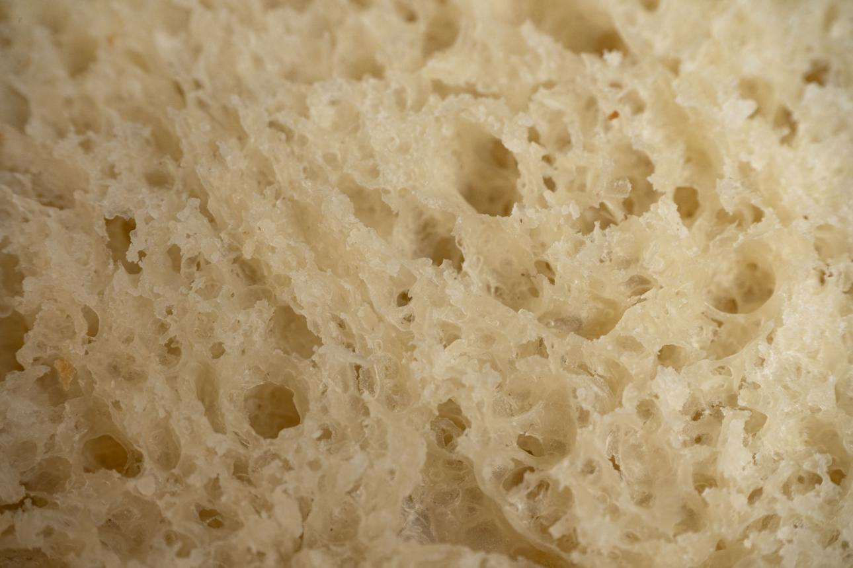
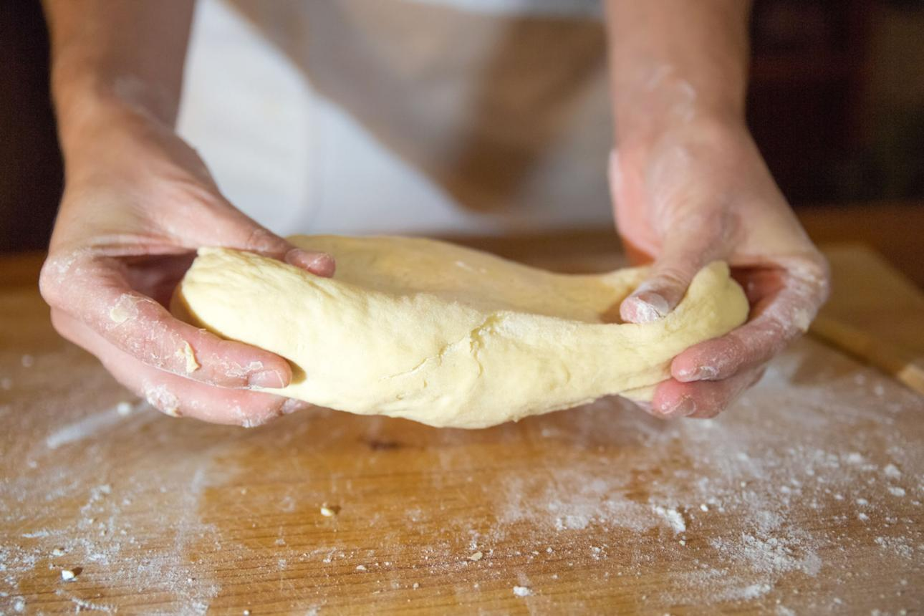
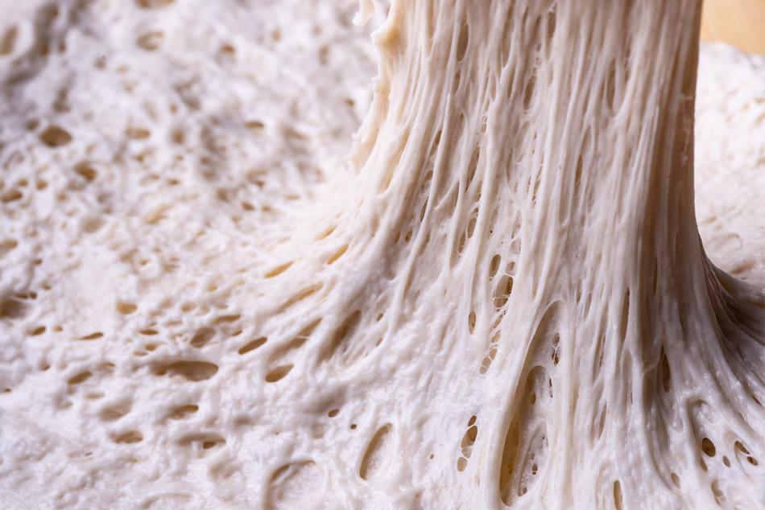

Examples of Gluten Formation (Other than your lab practical)
Bread Dough
Gluten network traps CO₂ produced by yeast
Leads to rise and soft texture

Slide 7
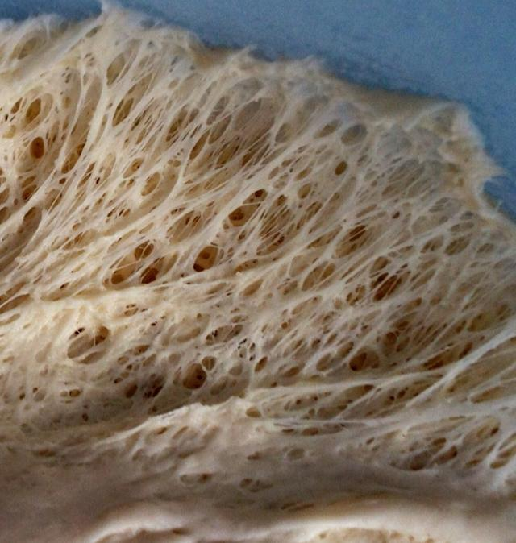
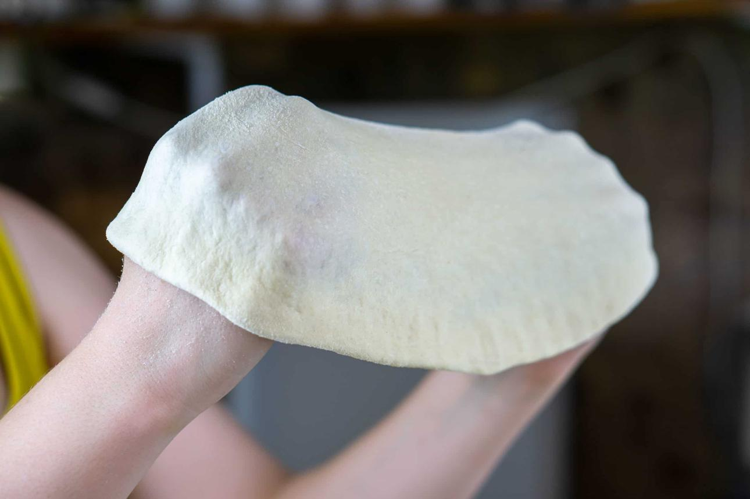
Examples of Gluten Formation (Other than your lab practical)
Pizza Dough
High gluten gives stretchability
Allows dough to be stretched without tearing

Slide 8
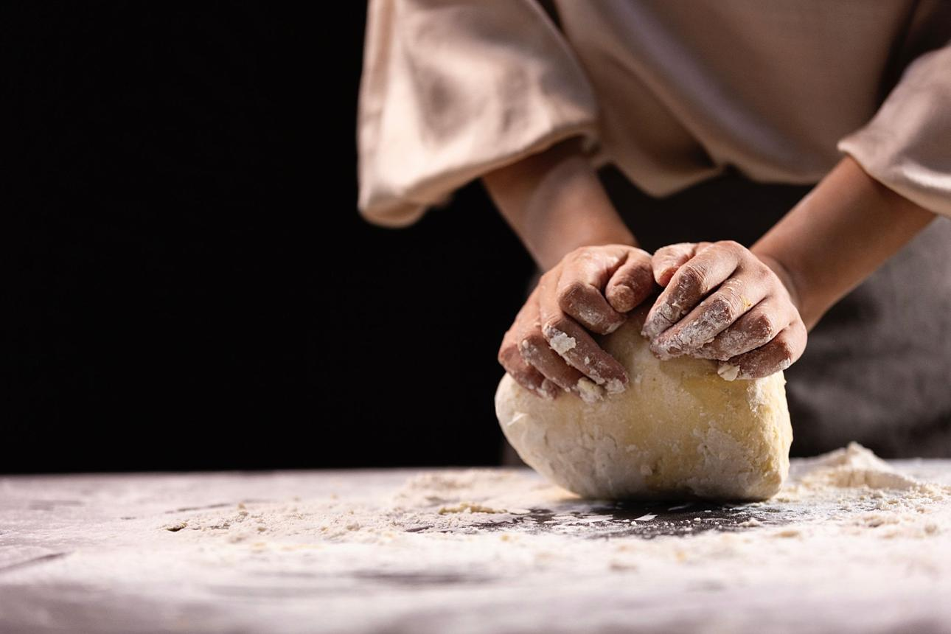
Examples of Gluten Formation (Other than your lab practical)
Pasta Making
Gluten provides firmness and bite (al dente texture)
Prevents disintegration during cooking

Slide 9
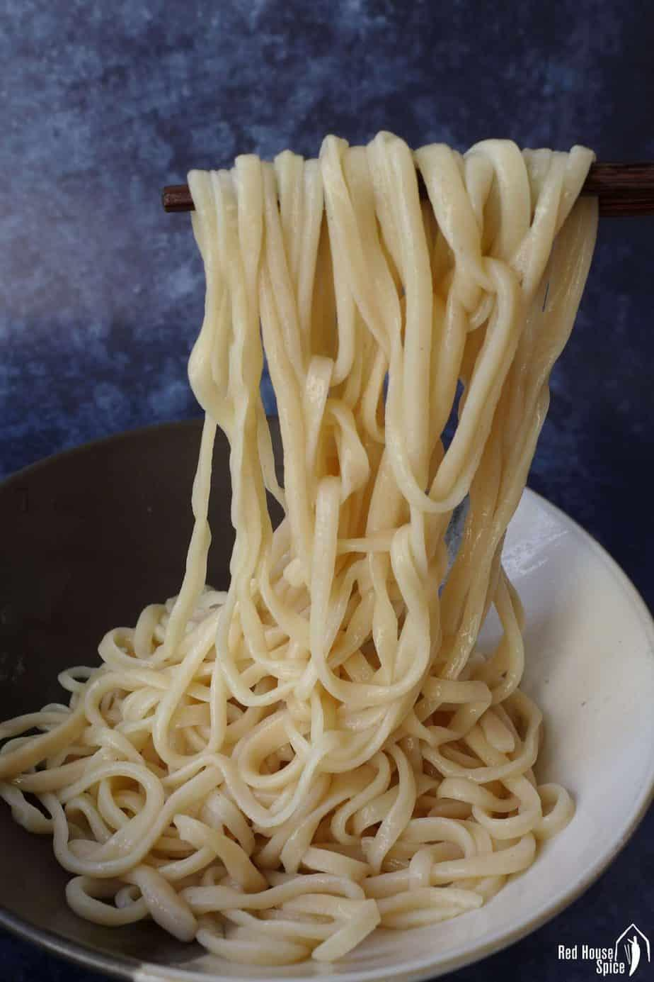
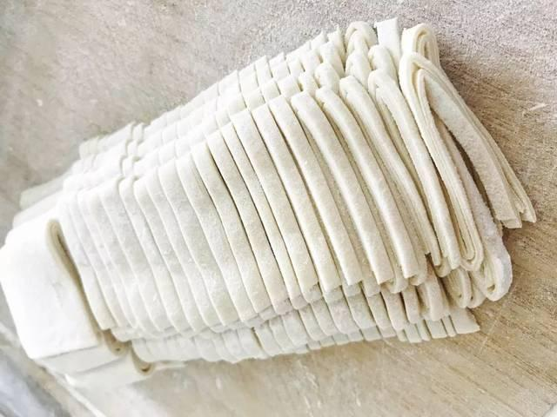
Examples of Gluten Formation (Other than your lab practical)
Noodles (Wheat-Based)
Gluten network provides elasticity and chewiness
Essential for stretching and pulling of noodles

